Slide 1
IMAGE SCRAPING AND CLASSIFICATION PROJECT
By- Rajesh Kumar Singh.

Slide 2
Problem Statement:
Images are one of the major sources of data in the field of data science and AI. This field is making appropriate use of information that can be gathered through images by examining its features and details. We are trying to give you an exposure of how an end to end project is developed in this field.
The idea behind this project is to build a deep learning-based Image Classification model on images that will be scraped from e-commerce portal. This is done to make the model more and more robust.
This task is divided into two phases: Data Collection and Mode Building.

Slide 3
Conceptual background of domain problem
Image Classification is a fundamental task that attempts to comprehend an entire image as a whole. The goal is to classify the image by assigning it to a specific label. Typically, Image Classification refers to images in which only one object appears and is analyzed. In contrast, object detection involves both classification and localization tasks, and is used to analyze more realistic cases in which multiple objects may exist in an image.
Image classification is the primary domain, in which deep neural networks play the most important role of medical image analysis. The image classification accepts the given input images and produces output classification for identifying the labels for those images.

Slide 4
HARDWARE AND SOFTWARE USED Hardware Used: RAM: 4 GB CPU: INTEL Core i3, 1.99GHz. GPU: NVIDIA GETFORCE RAM: 4 GB. Software used. Programming language : Python Distribution : Anaconda Navigator Browser based language shell : Jupyter Notebook Libraries/Packages specifically being used. Pandas, NumPy, matplotlib, seaborn, Tensor flow, keras, NLTK.

Slide 5
Data Collection:
As per the problem statement I have scraped images of saris, jeans and trousers from amazon website. To fetch more number of images I have used some of the filters so that we can get various kinds of images as well. For this project I have collected nearly equal amount of images from each category so that our model can be trained to recognize each class with good accuracy. Around 7331 images (sarees: 2406, Jeans: 2556 and Trousers: 2370).And also I have shared the image scraping script in GitHub repository.

Slide 6
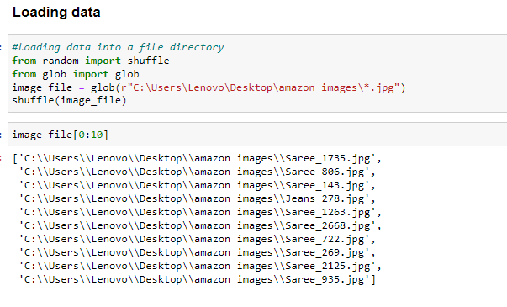
Analytical Problem Framing
In this project our task is to build a Deep Learning model to recognize a particular image. Here we need to identify images among three categories (Saree, Jeans, and Trouser). So we need to train a deep learning model with several images of these three types. As we have already scraped images from amazon.in so we will use these images to train our model.
I have loaded the folder of images into a file named as image_file, after that I have shuffled the file to feed our model.

Slide 7
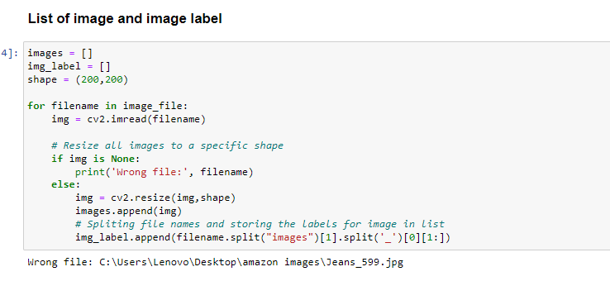
Data Processing:
After loading the data first we need to get the labels for each image, as here we don’t have labels readily available with us I will get the label for each image from corresponding file name using split function.
In above code I have created empty lists for images and labels. I am resizing every image to shape (200,200) and getting labels from the file name using split function.

Slide 8
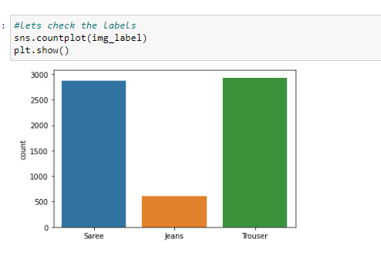
EDA
Looking at the above count-plot for labels we can say that we are having nearly same range of each category. Jeans are slightly more in numbers

Slide 9
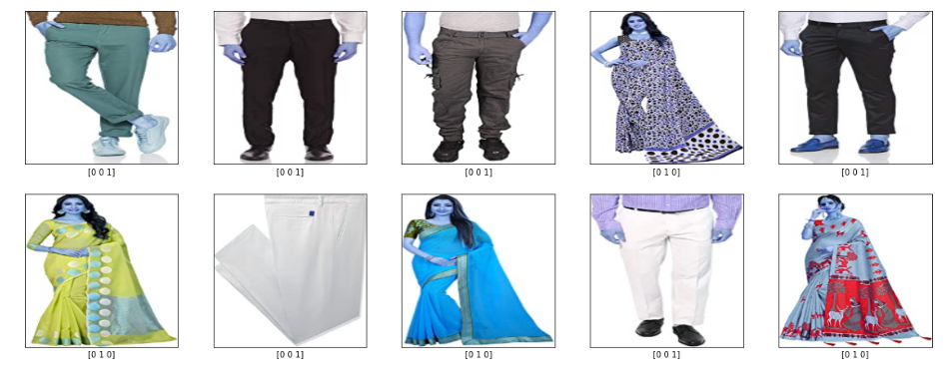
Ten random images with labels:
Looking at above two figures we can see the images and their respective labels as a sparse matrix.
Jeans = [1 0 0], Saree = [0 1 0], Trouser = [0 0 1]

Slide 10
Model Building and Evaluation:
After doing all the required data processing and visualizing steps I have built 5 different Deep Learning models (Sequential) with different convolution layers and fully connected layers, activation functions and optimizers.
For this project I have used 4 convolution layers with filter size (3, 3), Max Pooling. And these models have been trained with 3 epochs with batch size 50.
Among these four models I have selected third model which is giving me a good accuracy, f1_score, precision and recall for as our final model (Because of Ram/memory problem I have not applied Hyper tuning separately).
As this is classification problem I am using accuracy score here.
I have also checked for f1_score, precision, recall to ensure the better performance of our model. For this purpose I have built three functions to evaluate with these metrics.

Slide 11
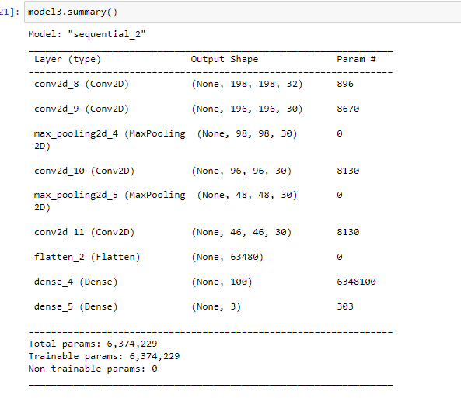
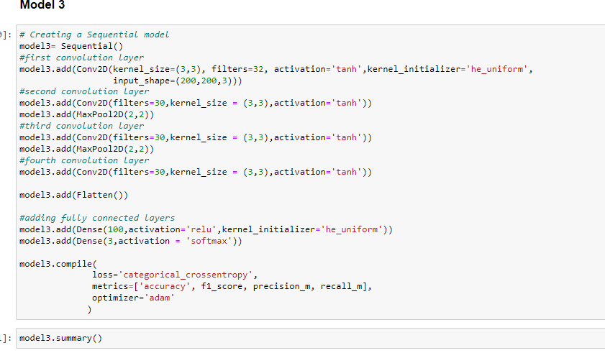
Final Model
For this model I am using a sequential model with four convolution layers along with tanh activation function. And two Dense layers.
Here I have added kernal_initializer as "he_uniform" at first convolution layer and at first Dense layer.

Slide 12
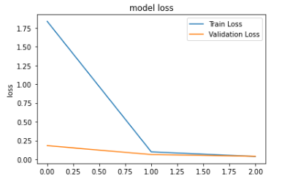
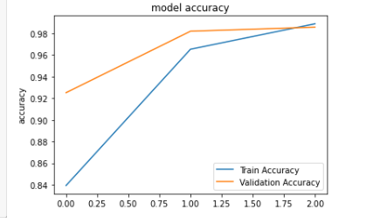
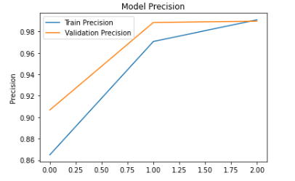
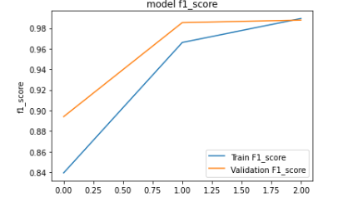
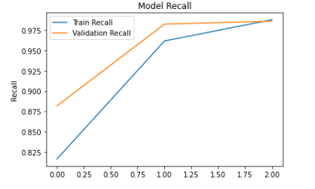
Model Summary: Here I have plotted graphs for model history with different evaluation metrics.

Slide 13
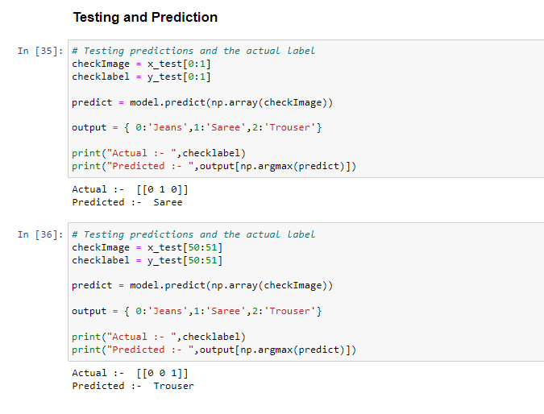
Testing actual vs predictions:
Great, we can see our model is predicting the images accurately.

Slide 14
Conclusions:
For this image classification project I have scraped images from amazon.in, after doing required data processing and visualizing the images I have built several models among them one is selected with higher performances.
We can still improve our model performance by feeding large numbers of images to our model and by doing extensive hypertuning for different parameters.

Slide 15
THANK YOU

